Slide 1
IBM CAPSTONE PROJECT – The Battle of Neighborhoods:
Analysis of London Real Estate Market by Mohammad Asif

Slide 2
Contents of the presentation:
Introduction to Business Problem
Data Description & Source of the Data
Data Methodology/EDA/Inferential Statistical Testing
Results
Discussion/Observation
Conclusion

Slide 3
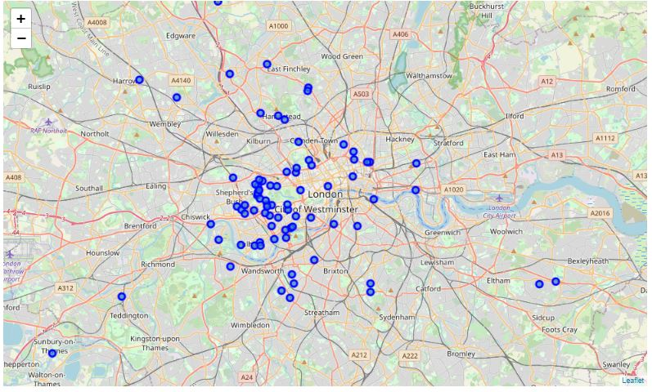
Introduction to Business Problem

Slide 4
Introduction to Business Problem (Contd.)
London Housing Market is in a rut:
Brexit
Hidden price falls
Record-low sales
Homebuilder exodus
Tax hikes addressing overseas buyers of homes in England and Wales
How could we provide support to homebuyers clientele in to purchase a suitable real estate in London in this uncertain economic and financial scenario?

Slide 5
Data Description & Source
The data on London real estate were extracted from the HM Land Registry from the link (http://landregistry.data.gov.uk/).
This data will help us to play around with our coding because our all coding will depend upon it.
To explore recommended locations across different venues according to the presence of amenities and essential facilities, we can access data through FourSquare API interface and arrange them as a dataframe for visualization.
By combining data on London real estate and the relative price paid data from the HM Land Registry and data on amenities and essential facilities surrounding such properties from FourSquare API interface, we will be able to recommend profitable real estate investments.

Slide 6
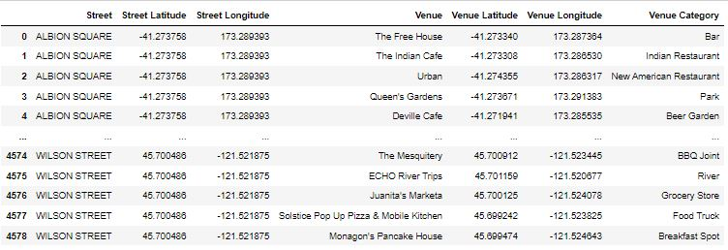
Data Methodology/EDA/Inferential Statistical Testing
Here we need the concept of data methodology. The Methodology section will describe the main components of our analysis and predication system.
The Methodology section comprises five stages which are:
Collect Inspection Data
Explore and Understand Data
Data preparation and preprocessing
Modeling
Data Visualization

Slide 7
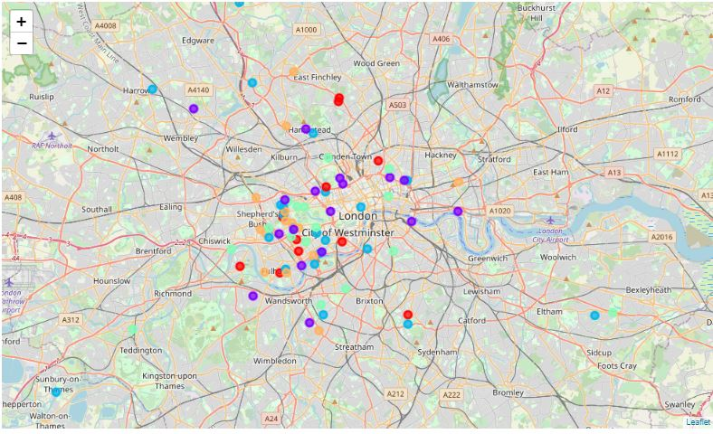
Results:
Even though the London Housing Market is facing a temporary bad times, it is still an "ever-green" for business affairs.
One can still invest in real estate market because from the data we can conclude that it is a temporary situation and overall the real estate market has a vast space to grow.

Slide 8
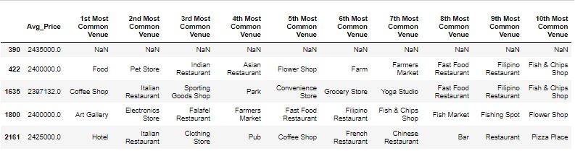
Discussion/Observation :
We observe the main point as:
One can examine them according to neighborhoods. It is interesting to note that, although West London (Notting Hill, Kensington, Chelsea, Marylebone) and North-West London (Hampsted) might be considered highly profitable venues to purchase a real estate according to amenities and essential facilities surrounding such venues i.e. elementary schools, high schools, hospitals & grocery stores.

Slide 9
Conclusion:
Examination of real estates according to neighborhoods/London areas
West London (Notting Hill, Kensington, Chelsea, Marylebone) and North-West London (Hampsted) might be considered highly profitable venues to purchase a real estate;
South-West London (Wandsworth, Balham) and North-West London (Isliington) are arising as next future elite venues with a wide range of amenities and facilities.
Examination of real estates by clusters
Clusters 0, 2 and 4 may target home buyers prone to live in 'green' areas with parks, waterfronts;
Clusters 1 and 3 may target individuals who love pubs, theatres and soccer.

Slide 10

End of Presentation

